Slide 1

Inferring Group Identities on Twitter
Asaf Beasley, Winter Mason
Social Seminar 4/12

Slide 2
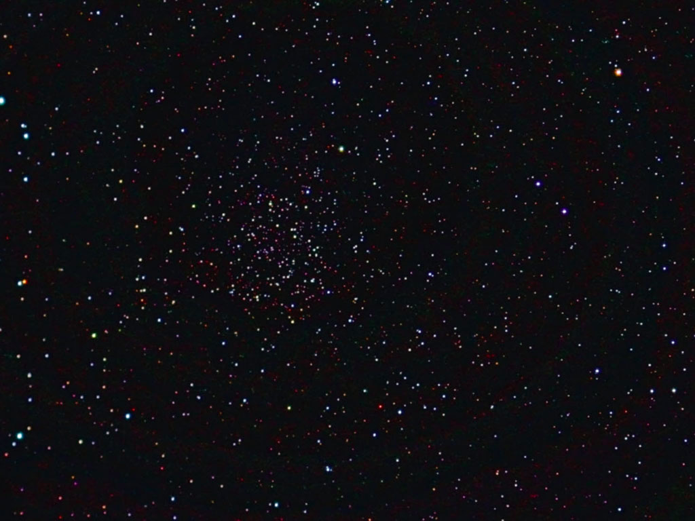

Slide 3
Can current methods of Latent Attribute Inference predict group identities of “casual” Twitter users?

Slide 4

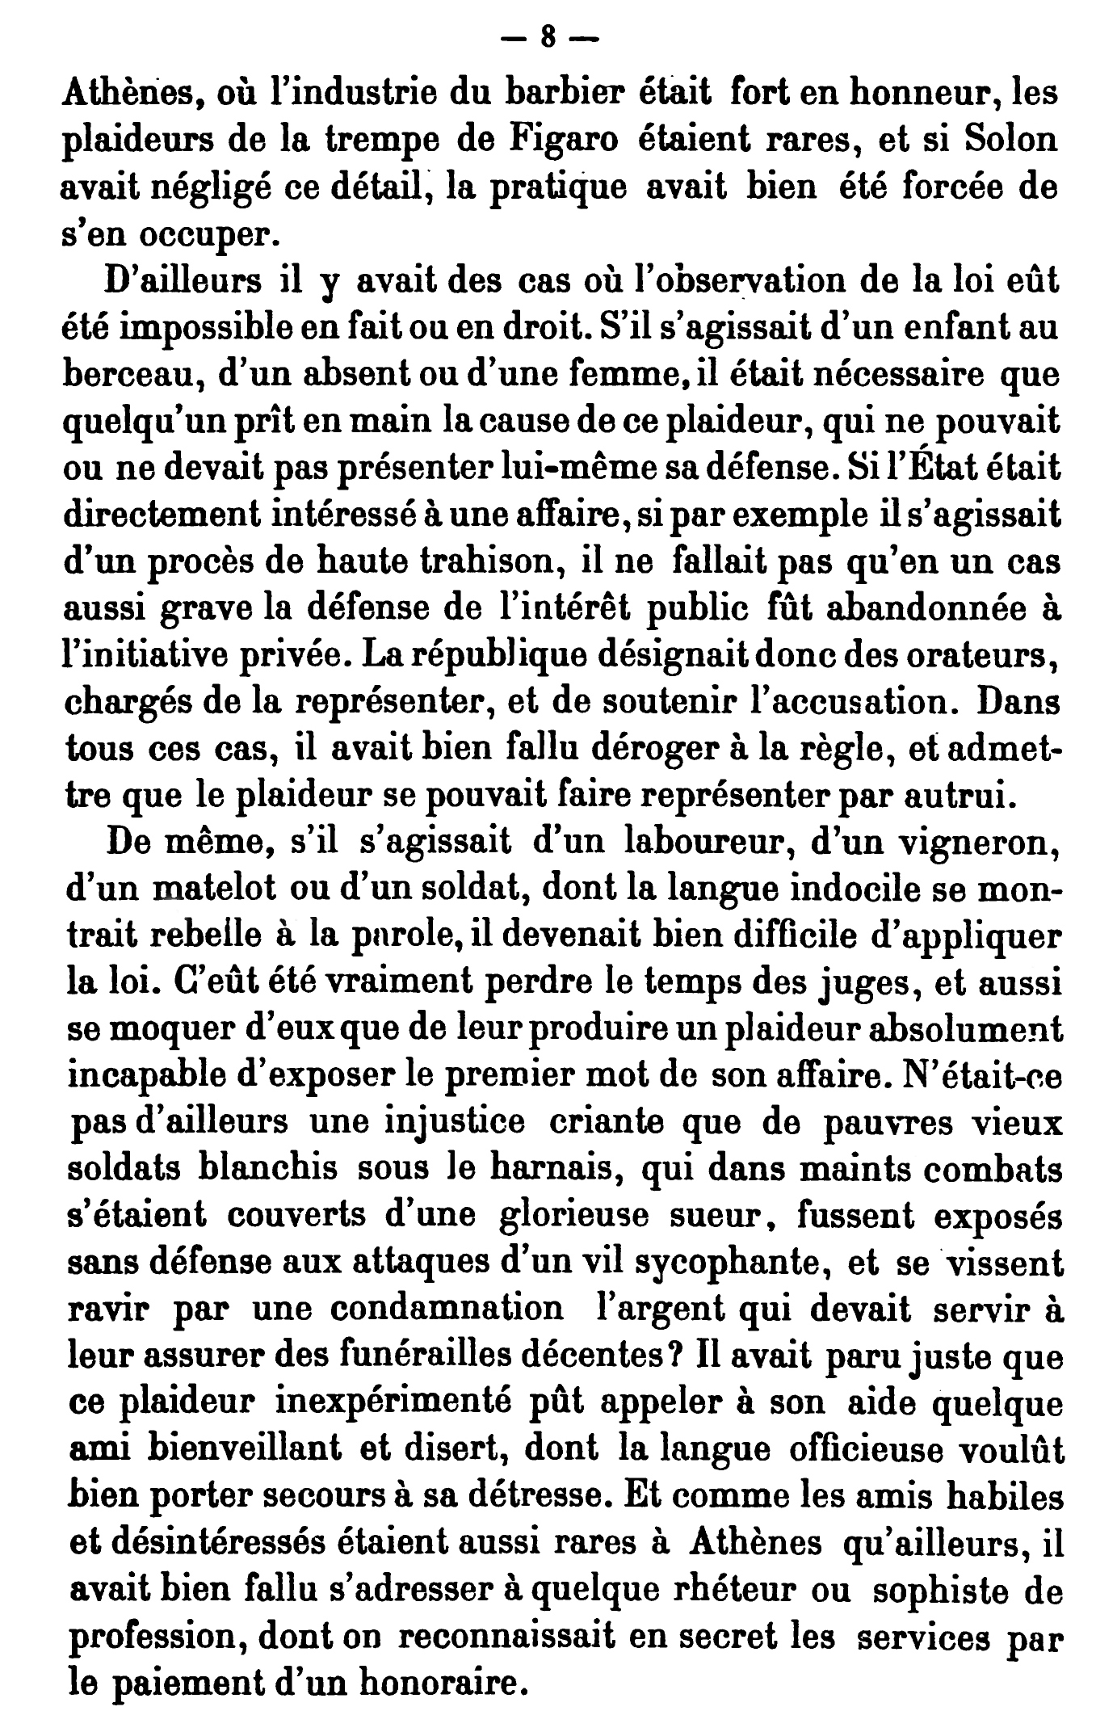




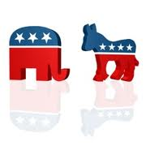
“Latent attribute inference"

Slide 5
Terms
Group Identity:
“those aspects of a person’s self-concept based upon their group memberships together with their emotional, evaluative and other psychological correlates”
-Turner & Oakes 1986
TWITTER – Followers, Followed, hash-tags #

Slide 6
Significance
Recommender Systems
Advertising
Basic Social Science Research- Describe and Isolate networks of different types of people.

Slide 7
What Makes Prediction Possible?
2 past studies from Twitter

Slide 8
Rao, Yarowsky 2010

Slide 9
Pennacchiotti & Popescu 2011

Slide 10




Past Samples

Slide 11
Past Info
Binary- e.g. Republican or Democrat, No strength of identification

Slide 12

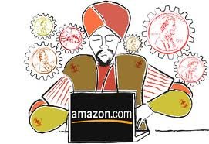
Our Sample
1392 Survey Respondents (mostly from IU subject pool)
756 Females
530 Males
106 Not Specified

Slide 17
Survey

Slide 18
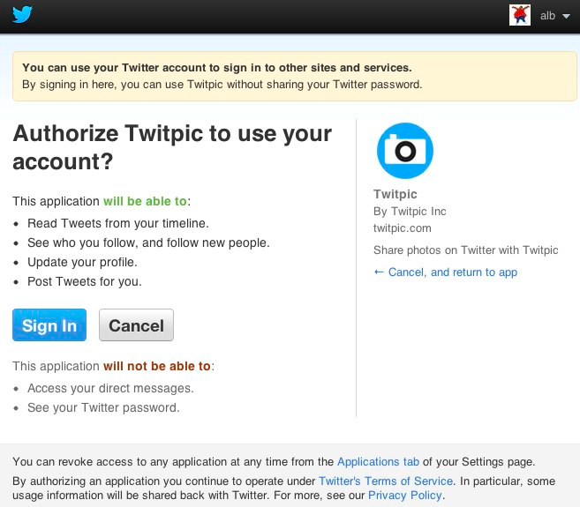

Slide 19
Survey Questions
14 question, 5 factor (Leach et al 2008) Political Identity, National Identity
Solidarity “I feel a bond with [in-group]”
Satisfaction “I am glad to be [in-group]”
Centrality “I often think of the fact that I am [in group]”
Individual Self-Stereotyping “I am similar to the average…”
In-Group Homogeneity “[In-group] people have a lot in common with each other
Self-Nominated Identities

Slide 21
Relax, You’re Doing Great

Slide 22
Twitter Data
-Up to 3200 tweets per person
-Up to 1000 Tweets from each of the individuals they follow
Approximately 82,000,000 Tweets total
Approximately 500,000 tweets from our participants (What I’m talking about today)

Slide 23
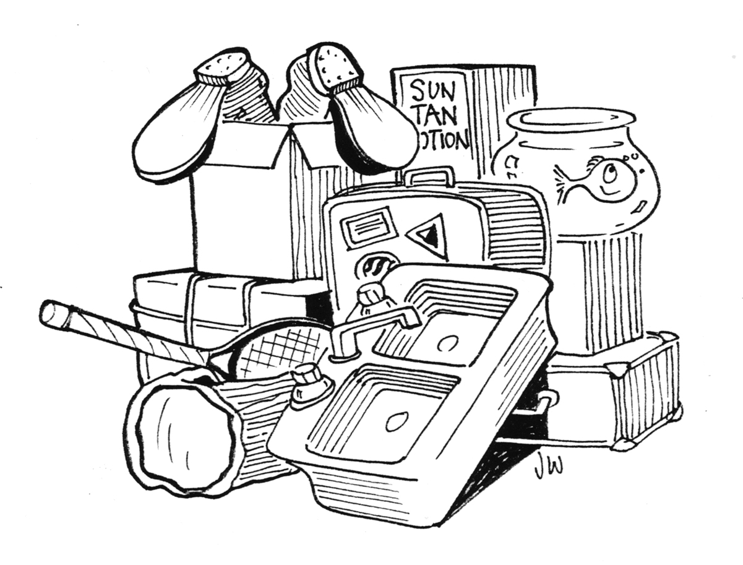
Modeling

Slide 24


Slide 25
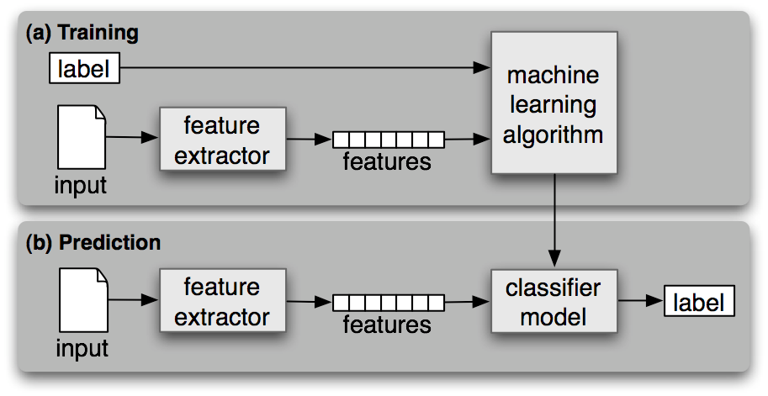
Supervised Learning

Slide 26
What We are Doing Currently
Replicating Zamal et al 2011
“Most distinctive” features for just our participants to start.
Features: single words, hashtags, bigrams, trigrams, stems, who someone follows

Slide 27
Most Distinctive Words Example
2 sets: Democrats and Republicans
Score:
Frequency Within Class/Frequency within all classes
Take 200 with top ratio (But we sum these up)
For Users:
Take set of all words appearing in Vector above- Take relative frequency of K_most words within this set.

Slide 28
3 Phase
Seed
Training (Support Vector Machine-SVM)
Testing

Slide 29

Many Parameters
-Size of Seed, Development, Testing Sets
-Filters on the bigram and trigram measures.
-Filters on the frequency of candidate distinctive terms, minimum number of users in the seed population using a term
-Parameters on the Machine Learning Algorithm

Slide 30

Political Figures/Salient Users

Slide 31
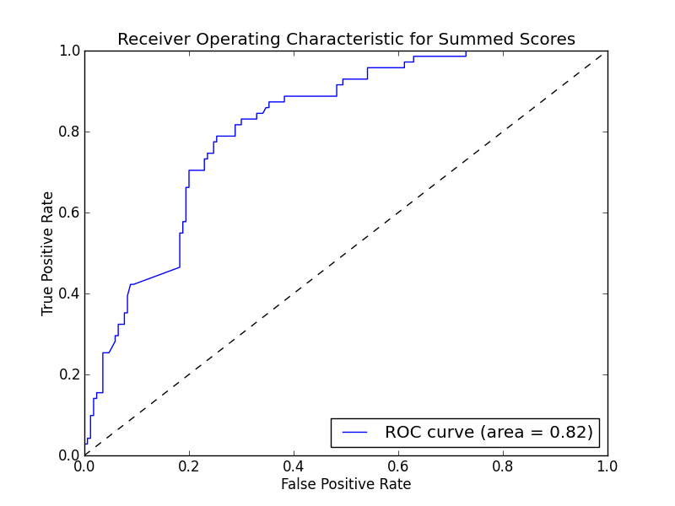
Gender

Slide 32
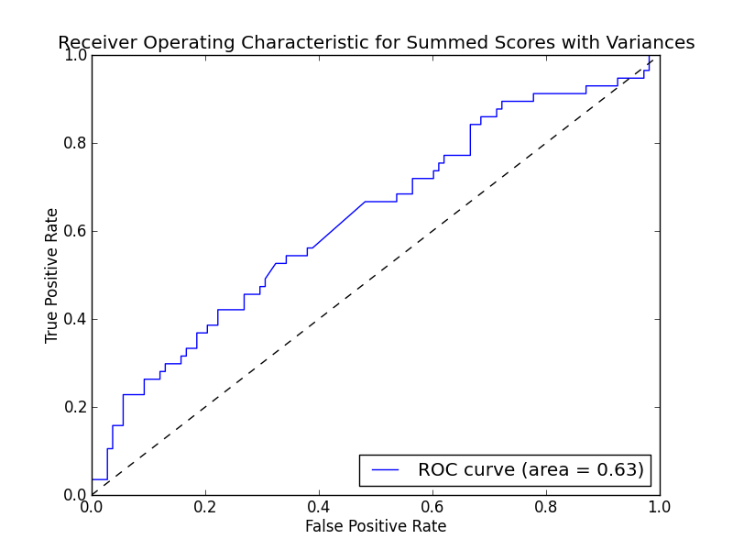
Our Sample- Seed Users Normal (Accuracy .62)

Slide 33
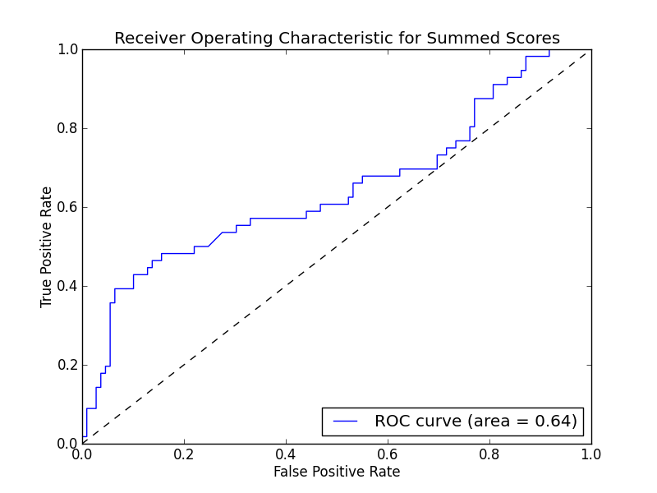
Our Sample: Seed Users Salient

Slide 34
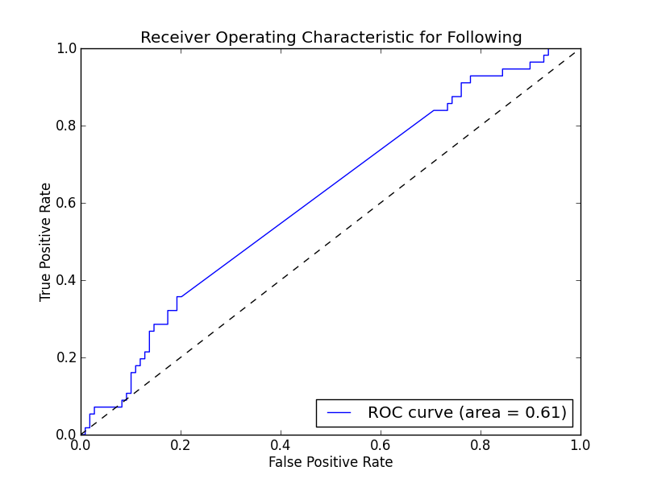
Best Individual Feature: Who People Follow (Accuracy .63)

Slide 35

Overall- Politics Classification for our Users

Slide 36


Slide 37
Reasons
Distinctive features are not appearing frequently enough for our users (Sparse Score Vectors).
Distinctive features generated by our seed users are not predictive

Slide 38
Most Distinctive Hash-tag: Salient Political Users
Group 1: #cutswecantafford, #healthcarereform, #bigoil, #jobcreation, #civilrights, #romneynotready
Group 2:#obamagenda,#prolife, #stopthetaxhike, #cutspendingnow

Slide 39
Gender Hash-tags
'#tswift', '#lolz', '#sisters', '#pwease', #happygirl, '#haha', '#rush', '#sos', '#lastnight', '#prettyplease', '#bestdayever', #thingsmydaddytaughtme, #boyfriend, #imissyou
VS
#halo, '#gameday', '#colts', '#collegegameday’, '#noshavenovember', '#puckfurdue', '#ravens', '#salty', '#thatisall', '#storybehindmyscar'

Slide 40
Our Users, Politics
Group 1: #greatnight', '#loser', '#recruitment', '#csflove', '#roadtrip', '#seriouslythough', '#confused’, '#jesuspiece', '#summer'
Group 2:#obama', '#ff', '#lmfao’, '#thewalkingdead', '#again', '#swerve', '#win', '#halo', '#election', '#thestruggle'

Slide 41
Possible Solutions
Do analysis for network members- might get a more coherent signal.
Find more and better features

Slide 42
Other Features
Topic Analysis-Latent Dirichlet Allocation (LDA)
Content of URLs posted
Deeper Linguistic Features:
I, me, mine,
We, us, our, ourselves
They, them, their, themselves

Slide 43
Features Continued
Linguistic Inquiry Word Count (LIWC)
Many Categories (Emotions, Money, Religion, Occupation, Family, Friends, Tenses…)

Slide 44
Major Point
Robust tools for Latent Attribute Inference require training and validation on NORMAL samples.
Salient Users are easy to classify, the harder more important problem still remains.

Slide 45

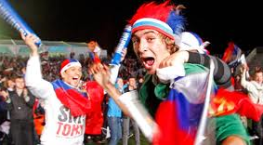

Next- Self Nominated Groups

Slide 46
Our Followers
Experiment
Validation with Users- unlisted identities

Slide 47
Future
Have a framework in place for Latent Attribute Inference on Twitter
Abstractly- Methodology can be recycled
Survey questions/experimental results can be used as a DV.
If the classifier works well- we can look at flow of information across networks. Activation of Identities at an individual level

Slide 48

Acknowledgements
Funding
Thomas Phillipeau
Thomas Imart
Kara Fasone
Entire Smith Lab

Slide 49


